Slide 1

Job Nexus 360
Team Details:
B. Krounchidhar (20EG105605)
B. Ashrith Nivyadin (20EG105608)
C. Shasank (20EG105610)
Dr. N. Swapna Goud
Assistant Professor, CSE
Department of Computer Science and Engineering
1

Slide 2
Introduction
A job website is an online platform that connects job seekers with employers. It serves as a digital marketplace where individuals can explore various job opportunities, submit applications, and interact with potential employers. Job websites often host a wide range of job listings across different industries, allowing users to search for positions based on their skills, qualifications, and preferences.
To operate a job website effectively, several components are essential:
User Interface and Experience Design: A user-friendly interface that enables easy navigation and efficient job search functionalities is crucial.
Job Listings Database: A robust database infrastructure to store and manage job listings, including features for sorting, filtering, and categorizing jobs.
Communication Tools: Messaging systems or email notifications to facilitate communication between employers and job seekers regarding application status, interview invitations, etc.
Security Measures: Robust security measures to protect user data, prevent fraudulent activities, and ensure privacy.
Mobile Compatibility: With the increasing use of mobile devices, ensuring compatibility and responsiveness across various devices and screen sizes is essential.
Department of Computer Science and Engineering
2

Slide 3
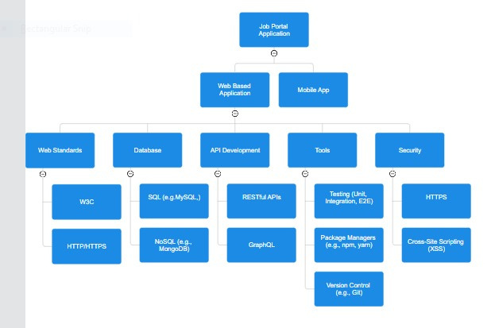
Concept Tree
1/28/2024
Department of Computer Science and Engineering
3

Slide 4
Literature
Author(s) | Strategies | Advantages | Disadvantages
G. Praveen | Simplify user interface | Easy and user-friendly | Less Flexibility
Aditya A. Shastri | Provide Feedback | Gain insights of the users | Unhappy users give bad feedback.
Shaohan Cai | Assessing Suitability | Can not login with out proper authorization | System functionality not achieved
Zheng Zhou | Integration with Emerging Technologies | Stay updated on industry trends | Limited Personalization
Nan Zhou | Employer-Focused Tools | Offer employers tools for efficient candidate screening | Challenges in managing the hiring process
1/28/2024
Department of Computer Science and Engineering
4

Slide 5
Problem Statement
In the dynamic landscape of the job market, traditional methods of job searching and hiring have become increasingly inefficient. The existing job portal websites lack advanced features, personalization, and seamless user experiences, hindering both job seekers and employers in finding suitable matches. There is a need for a comprehensive and innovative job portal that addresses the shortcomings of current platforms and provides a solution for the evolving needs of the job market.
Disadvantages:
Hidden Costs
Limited Visibility
Inaccurate or Outdated Listings
Department of Computer Science and Engineering
5

Slide 6
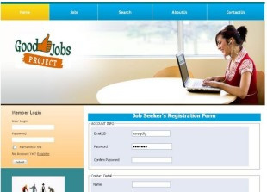
Problem Illustration
The user interface (UI) of the job website is not user-friendly and lacks intuitive navigation, causing frustration and difficulty for job seekers trying to navigate through the platform.
1/28/2024
Department of Computer Science and Engineering
6

Slide 7
Proposed Method
We aim to create a dynamic and intuitive job website that revolutionizes the way job seekers and employers connect in the digital age. By leveraging cutting-edge technology and innovative features, our platform aims to streamline the job search process, empower users with personalized job recommendations, and facilitate meaningful interactions between candidates and employers.
We are committed to delivering a seamless user experience, fostering a vibrant community of professionals, and serving as a trusted resource for individuals and businesses alike. Our vision is to empower every user to discover their dream job and unlock their full potential, while helping employers find the best talent to drive their organizations forward. Together, we aspire to reshape the future of recruitment and empower individuals to pursue rewarding career opportunities with confidence and ease
Department of Computer Science and Engineering
7

Slide 8
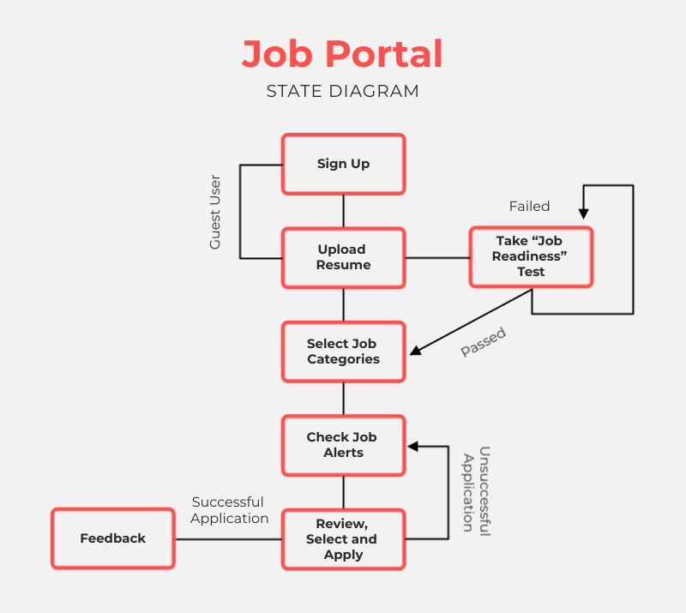
Proposed Method Illustration
1/28/2024
Department of Computer Science and Engineering
8

Slide 9
Parameters
1.User Engagement Rate (UER):
Formula: (Number of Active Users / Total Registered Users) * 100
Description: Measures the percentage of registered users actively engaging with the website.
2.Job Listing CTR (Click-Through Rate):
Formula: (Number of Clicks on Job Listings / Number of Job Listing Views) * 100
Description: Measures the percentage of users who click on job listings after viewing them.
3.Average Time Spent on Site (ATSS):
Formula: Total Time Spent on Site / Number of Sessions
Description: Indicates the average duration users spend on the website per session.
4.User Satisfaction Score (USS):
Formula: (Sum of User Ratings) / (Number of Ratings)
Description: Represents the average satisfaction rating provided by users for the website's features and services.
1/28/2024
Department of Computer Science and Engineering
9

Slide 10
Experiment Environment
Programming Language: Html, CSS, Javascript (MERN)
Working Environment: VSCODE
Node Version: 21.6.1
MongoDB Version: MongoDB 7.0
ReactJS Version: 18.1.0
Express Version 4.18.2
Packages: npm, yarn
Libraries React, JQuery
1/28/2024
Department of Computer Science and Engineering
10

Slide 11
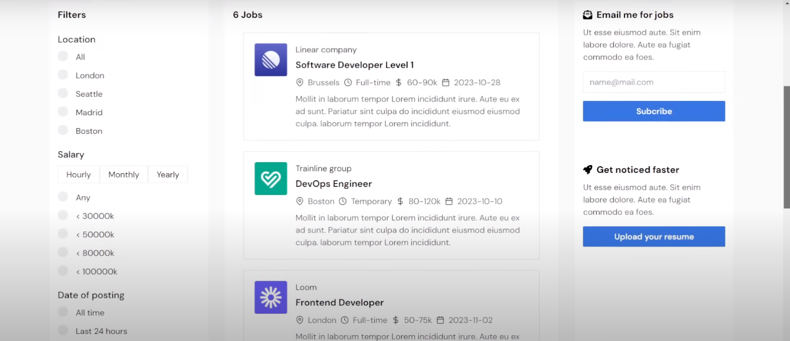
Experiment Screenshots
Department of Computer Science and Engineering
11

Slide 12
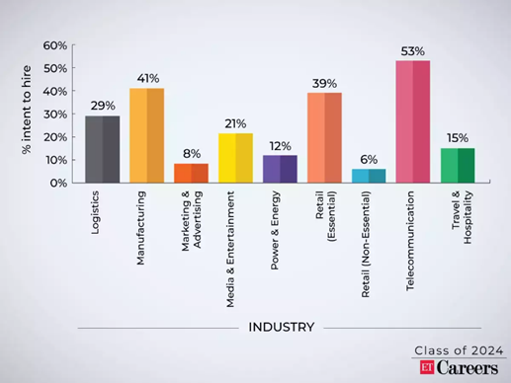
Results and conclusion
Job Trends Graph
Findings:
Differing Bar Heights: Shows which industries or job categories are experiencing the most growth/decline in postings.
Color Coding: Can highlight specific trends within industries (e.g., blue for growth, red for decline).
Department of Computer Science and Engineering
12

Slide 13
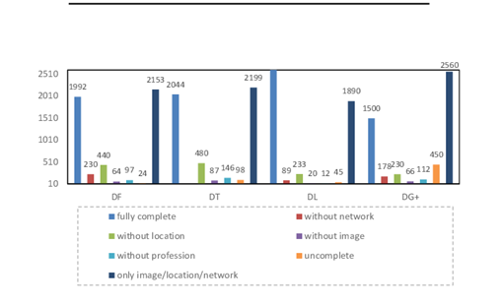
Results and conclusion
Candidate Profile Completeness Graph
Findings:
This graph tracks the completeness of candidate profiles registered on the job portal application.
It shows the percentage of required fields (e.g., work experience, skills, education) that candidates have filled out in their profiles.
Department of Computer Science and Engineering
13

Slide 14
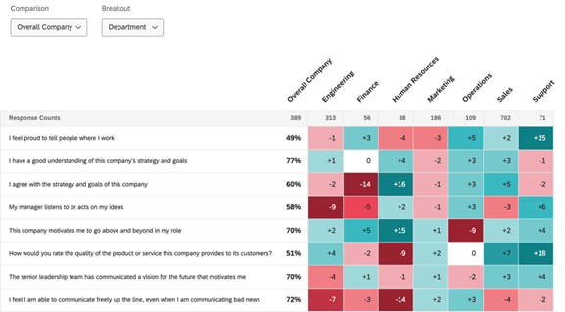
Results and conclusion
User Engagement Heatmap:
Findings:
A heatmap provides a visual representation of user engagement on the job portal platform.
It highlights areas where users spend the most time, such as specific job categories, search filters, or individual job listings.
Department of Computer Science and Engineering
14

Slide 15
Parameter comparison table
Parameter | Previous methods | Proposed method
Resume Type | One-size-fits-all resumes sent to multiple positions without customization. | Tailoring your application materials to highlight specific skills and experiences mentioned in the job description to get past ATS filters.
Screening Criteria | Resumes reaching a certain keyword threshold often went to human reviewers for a more in-depth evaluation. | Resumes reaching a certain keyword threshold often went to human reviewers for a more in-depth evaluation.
Application Type | Focus on Paper Applications Submitting physical applications instead of online submissions (becoming less common). | Application is submitted online via company website, job board, Job Portals, etc.
Department of Computer Science and Engineering
14

Slide 16
Project status
S.No | Functionality | Status
1 | Abstract | Completed
2 | Requirements | Completed
3 | Paper Writing and Journal Submission | Not yet started
4 | Implementation | In Progress
1/28/2024
Department of Computer Science and Engineering
15

Slide 17
References
[1] Alavi, M., & Leider, D. (1999). Knowledge management systems: Emerging views and practices from the field. In System Sciences, 1999. HICSS-32. Proceedings of the 32nd Annual Hawaii International Conference on (pp. 8-pp). IEEE.
[2] Yang, Zhilin, Shaohan Cai, Zheng Zhou, and Nan Zhou. "Development and validation of an instrument to measure user perceived service quality of information presenting web portals." Information & Management 42, no. 4 (2005): 575-589.
[3] Benbya, Hind, Giuseppina Passiante, and Nassim Aissa Belbaly. "Corporate portal: a tool for knowledge management synchronization." International Journal of Information Management 24, no. 3 (2004): 201-220.
[4] Saat, N.M.; Singh, D. "Assessing suitability of candidates for selection using candidates' profiling report", Electrical Engineering and Informatics (ICEEI), 2011 International Conference on, On page(1-6).
[5] Rafter, R., Bradley, K., & Smyth, B. (2000). Personalized retrieval for online recruitment Services, In Proceedings of the 22nd Annual Colloquium on Information Retrieval.
1/28/2024
Department of Computer Science and Engineering
16

Slide 18
Thank you
1/28/2024
Department of Computer Science and Engineering
17

